Slide 1
Asynch LS1
Johnny Vogt

Slide 2
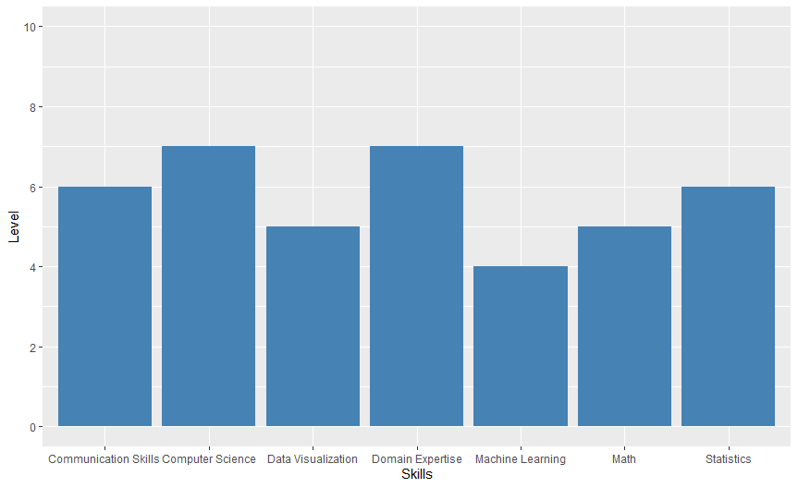
Skill Profile

Slide 3
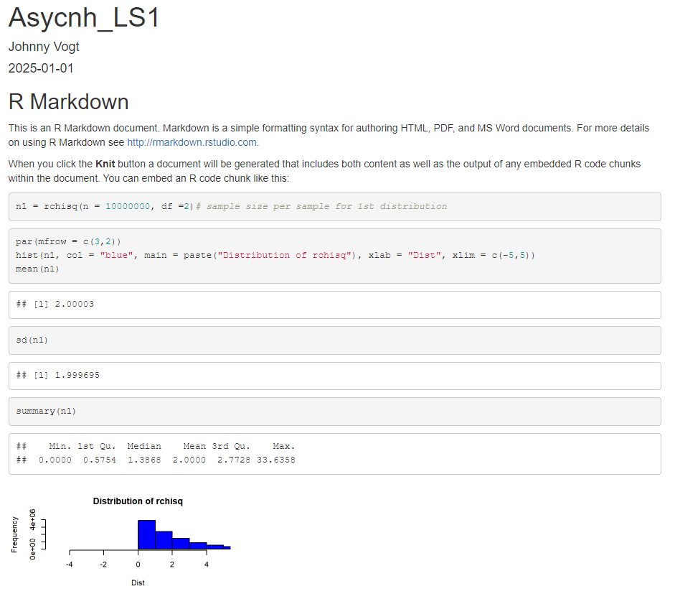
CLT Q2(1 - 3)
1. Made n1 equal to output of the “rchisq”
function
2. Used the “hist” function to create a histogram based off the data from n1
3. Used functions mean() and sd() to discover the mean and standard deviation of n1

Slide 4
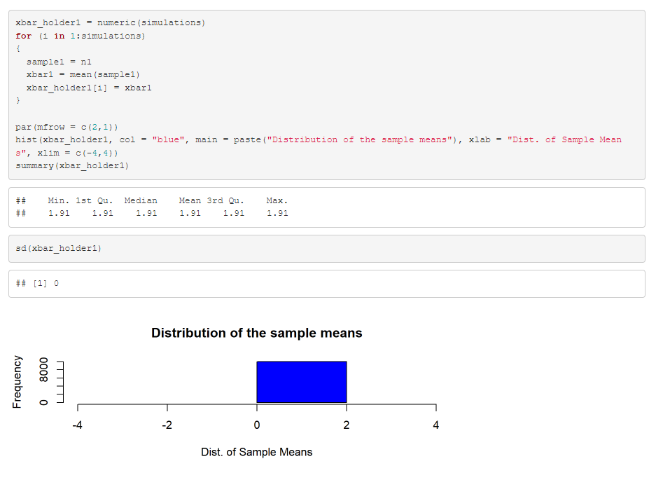
CLT Q2(4-6)
4. The Distribution should look closer to to a normal distribution based off the mean of samples. The mean should be roughly the same as reported in Q3. The standard error should be closer to 0 due to the high sample size.
5.Using the for loop, I was able to add all the means to the xbar_holder1 variable and created a histogram based off of xbar_holder1
6. Using the Summary and sd function I was able to determine the Mean and Standard Error of the Sample Means.

Slide 5
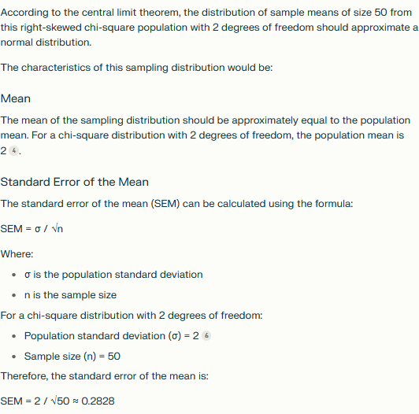
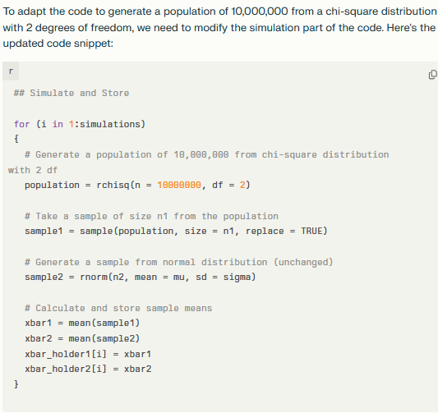
AI (Perplexity)
Attached RMD file and asked Perplexity to adap the code generate a population of 10 million. The AI changed the value of “Sample1” to meet the request usinmg the rchsq function
If the distribution was made of sample means, AI was able to determine that the distribution was normal. It was also able to provide the population mean and standard error.

Slide 6
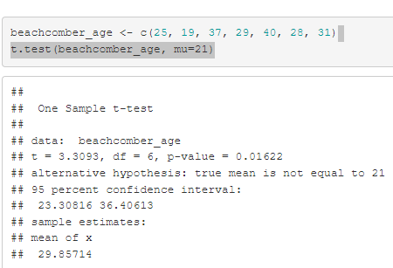
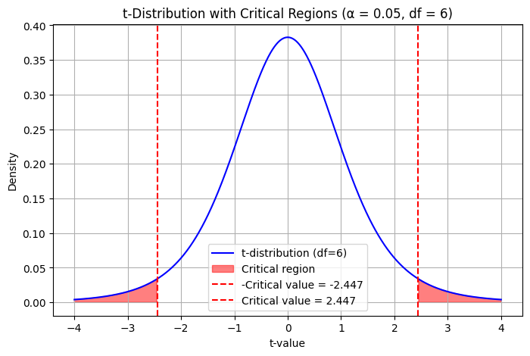
T-Test
1.H-null equals to 21 or H-alt does not equal to 21
2. Critical Value: +/-2.447
3.T-statistic: 3.3093
4.P-Value: 0.01622 5.Reject H-Null
6. Based on the data provided, there is enough evidence to suggest that the true mean age of the Beach Comber bar is not equal to 21. Since the P-Value of the sample is 0.01622 and is below .05, that is significant enough to reject H-Null
*Graph generated via AI (Perplexity)

Slide 7
Takeaways and Questions
AI can assist with simple steps, but has difficulty trying to solve complex and nuance problems.
Before this task, I had never used R/Rstudio.
Reading the “R” related textbooks definitely helped bridge a lot of gaps.
Questions and and my answers felt a bit simple that I feel that I might have missed something.

